Slide 1
Multi-Goal Path Planning Based on the Generalized Traveling Salesman Problem with Neighborhoods
by Kevin Vicencio
Aerospace and Mechanical Engineering Department
Embry–Riddle Aeronautical University
NASA Space Grant Symposium
April 11-12, 2014

Slide 2


Motivation
Objective: Path length for redundant robotic systems.
Travelling Salesman Problem (TSP):
Minimize tour length given a set of nodes
Widely Researched
Limitation: node location fixed
Bridge inspection scenario
Rescue mission scenario

Slide 3
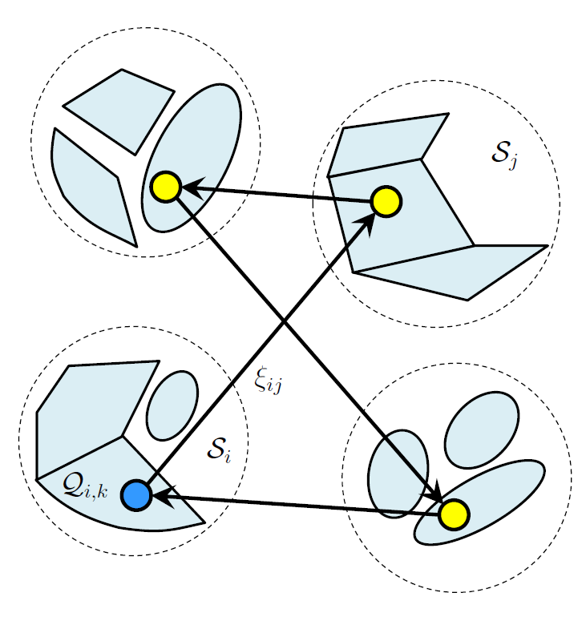
Problem Dimension
TSP with Neighborhoods (TSPN):
Neighborhood: Node can move within a given domain
Determine optimal sequence and optimal configuration
Limitation: Cannot account for non-connected neighborhoods
Generalized TSPN (GTSPN):
Neighborhood Set: Node can be located in different regions
Disconnected neighborhoods can be modeled using smaller convex regions

Slide 4
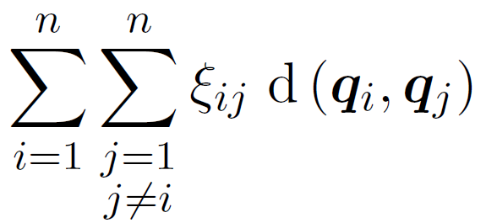





MIDP Formulation of GTSPN
Minimize:
Subject to:
Assignment Problem
(1)
DFJ Subtour Elimination
(2)
Neighborhood Set
(3)
(4)
Domain
(5)

Slide 5
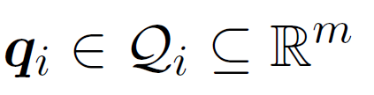




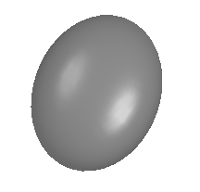




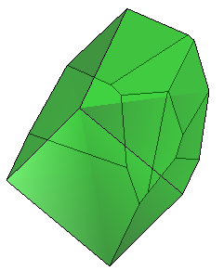
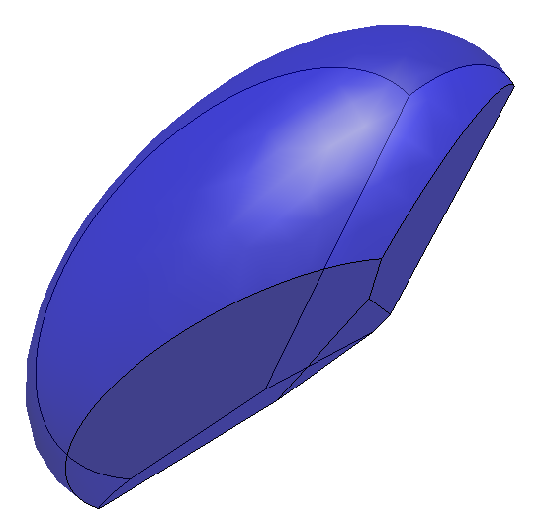
Neighborhoods
The used constraints (4) are:
ellipsoids: given symmetric positive definite matrices and vectors , center of the ellipsoid
polyhedra: given matrices and vectors
hybrid (multi-shaped): combination of rotated ellipsoids and polyhedra

Slide 6
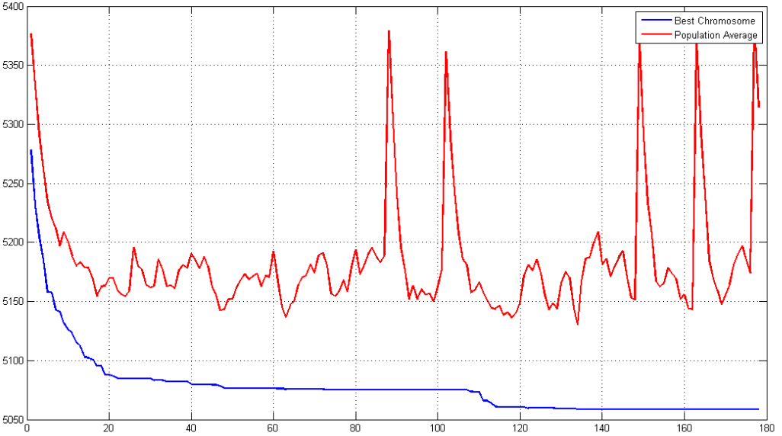
Hybrid Random-Key Genetic Algorithm
Genetic Algorithm:
Numerically obtain minimum
Function to be minimized: Distance
Utilize Natural Selection Techniques
  Crossover Operator
  Heuristics
Chromosome Interpretation:
  Sequence: Random-Key
  Neighborhood: Index
HRKGA Convergence History
Objective Value (m)
Generation

Slide 7
Numerical Simulation Results
Average vs. Uniform
Alternative Crossover Investigation
Arithmetic Average Crossover Operator
  Offspring is arithmetic average of parents
  Mutates Index of neighborhood set
  HRKGA using Arithmetic Average operator
  is consistent within ±0.09% when determining
  tour
Uniform Crossover Operator
  Generate set of n uniformly, distributed random numbers
    If i-th element greater than a given threshold offspring inherits i-th gene of first parent.
    Otherwise, the offspring inherits the i-th gene of the second parent
  HRKGA using Uniform Operator is consistent within ±0.56% when determining tour
  On average HRKGA using Uniform Operator produces results:
    1.602% more cost effective
    0.920% less CPU Time

Slide 8
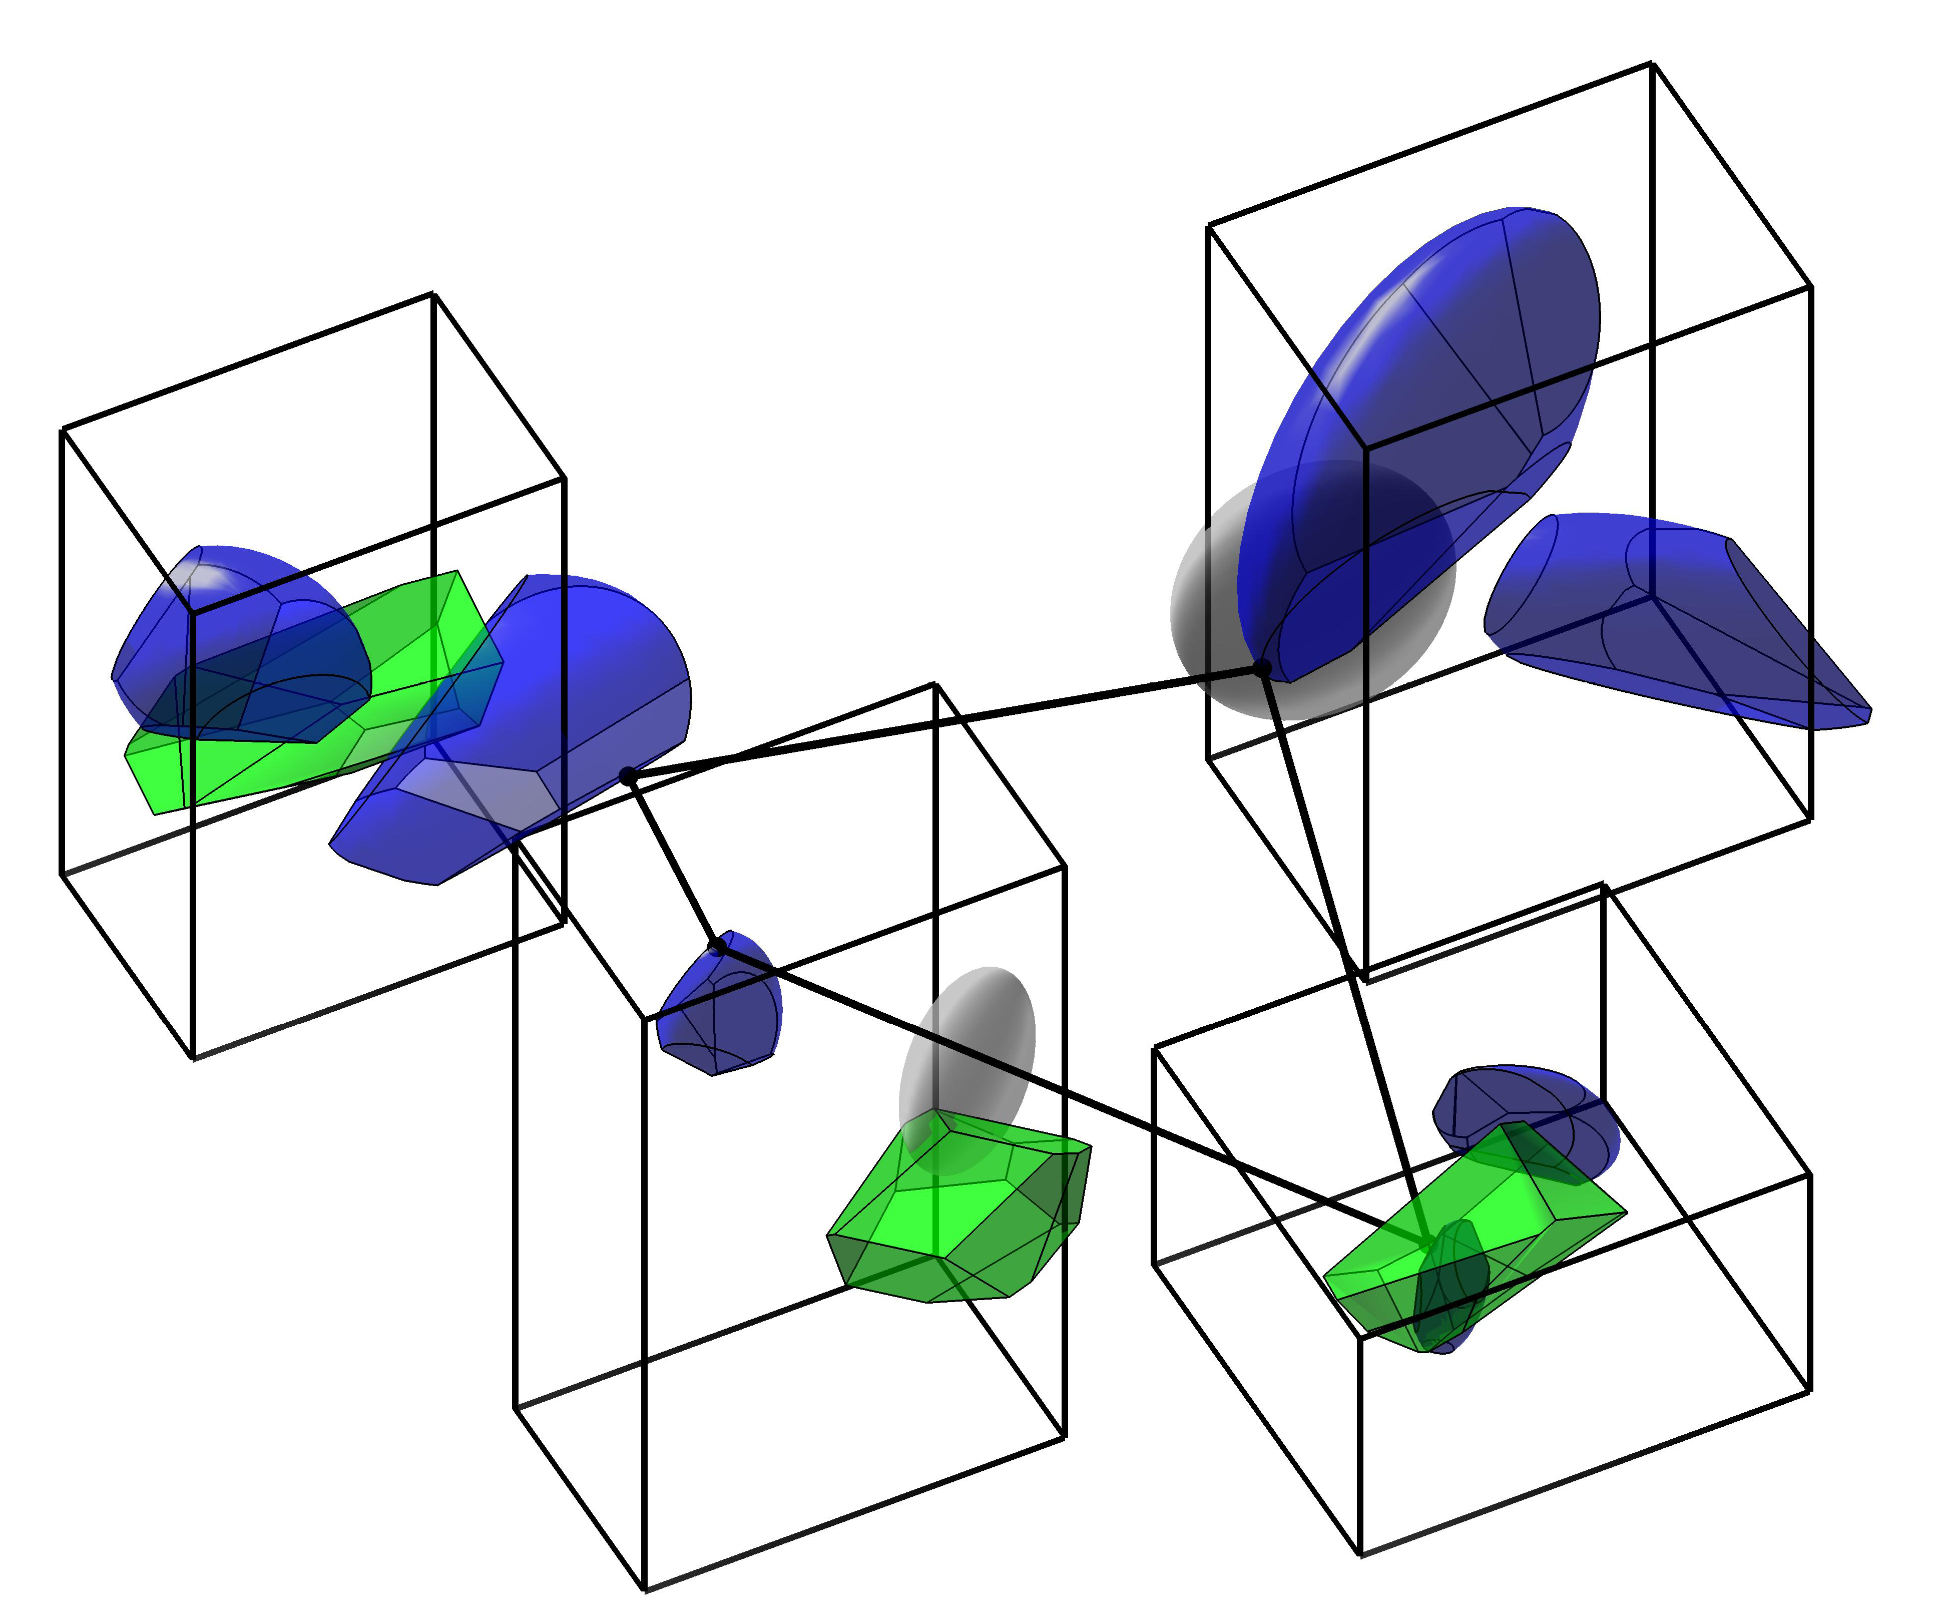
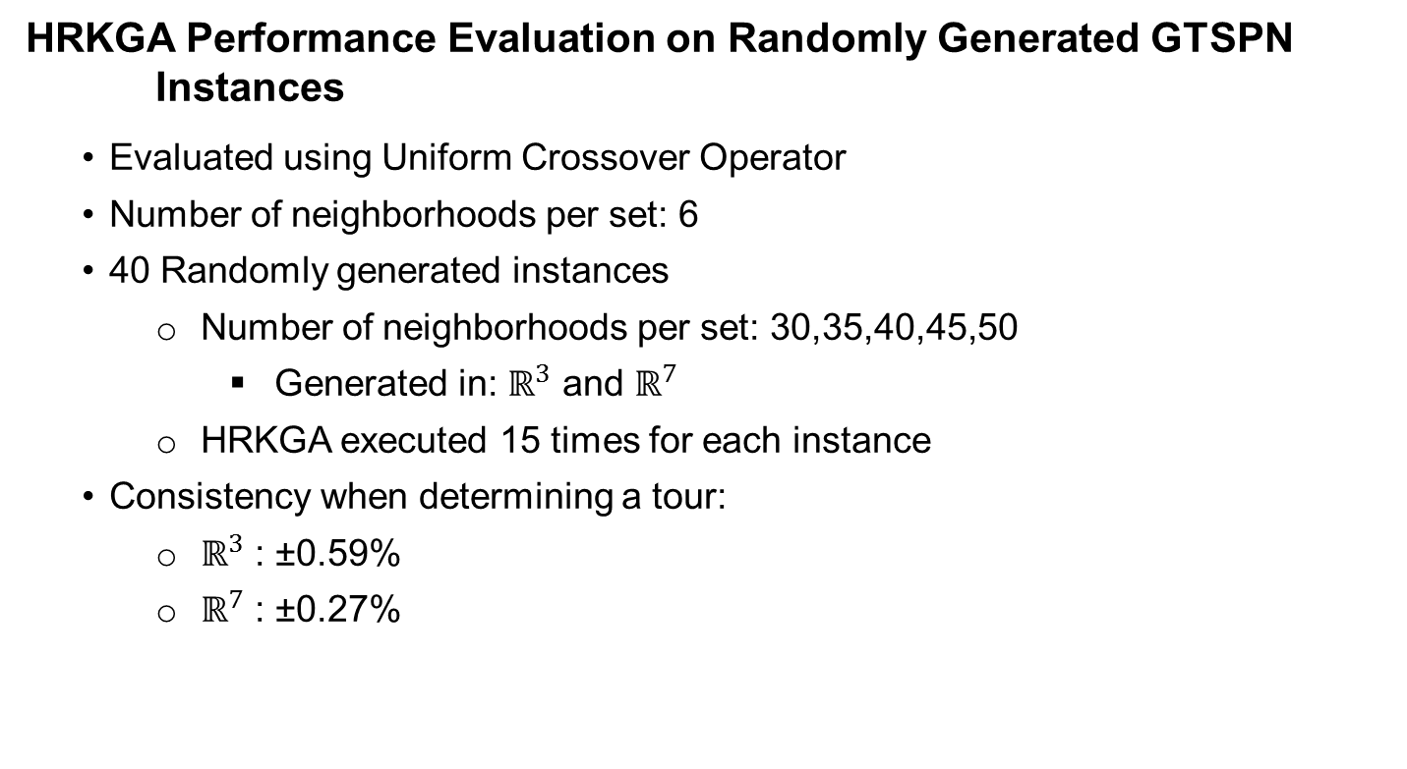
Numerical Simulation Results
HRKGA Performance Evaluation on Randomly Generated GTSPN Instances
Evaluated using Uniform Crossover Operator
Number of neighborhoods per set: 6
40 Randomly generated instances
  Number of neighborhoods per set: 30,35,40,45,50
    Generated in: $ℝ^{3}$ and $ℝ^{7}$
  HRKGA executed 15 times for each instance
Consistency when determining a tour:
  $ℝ^{3}$ : ±0.59%
  $ℝ^{7}$ : ±0.27%

Slide 9
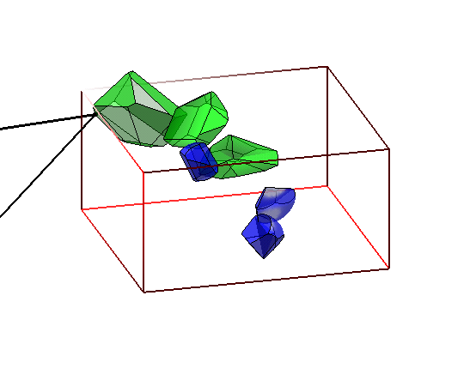
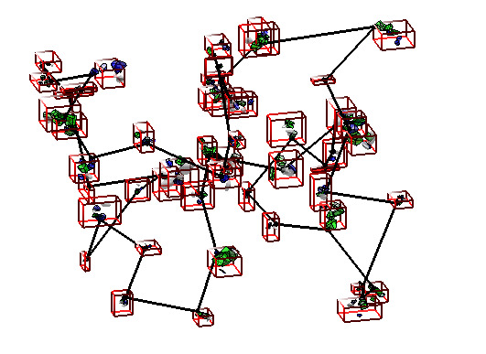

Near-Optimal Tours for GTSPN Instances
Random GTSPN Instance: $ℝ^{3}$, m = 6, n = 50

Slide 10
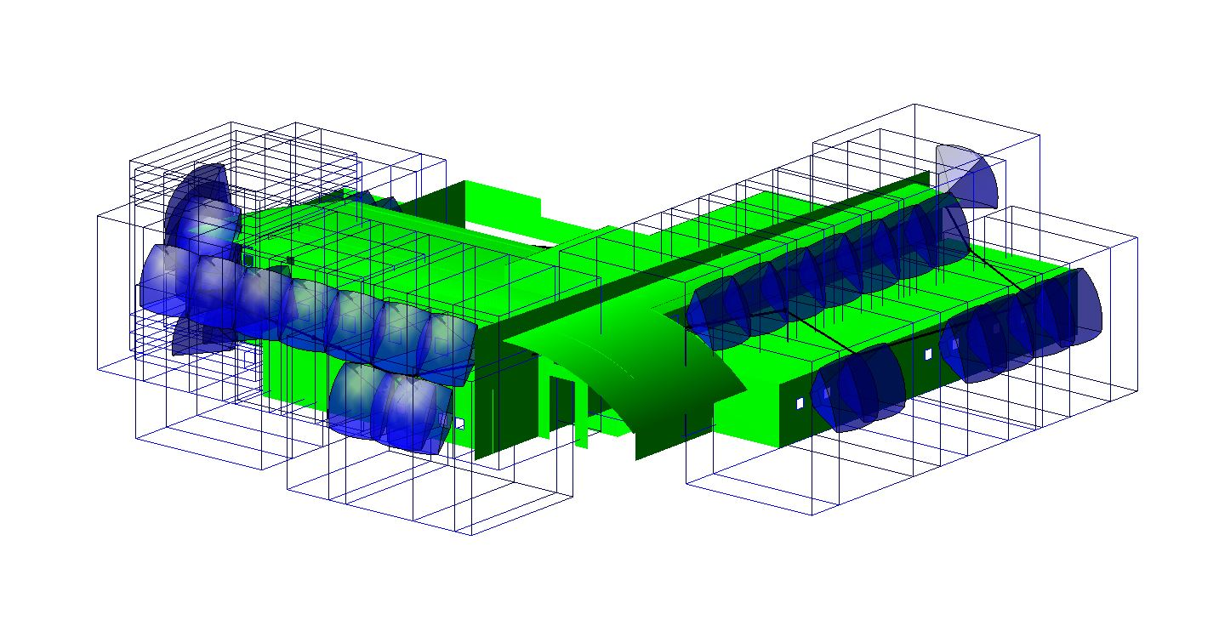
Practical GTSPN Instance

Slide 11
Future work
Algorithm:
Incorporate Dynamic Constraints
Incorporate Obstacle Avoidance
Physical Systems:
Implement Genetic Algorithm on multi-rotor vehicle
Optimize energy consumption

Slide 12


Acknowledgment
Embry–Riddle Aeronautical University:
Dr. Iacopo Gentilini
Dr. Gary Yale
IBM Academic Initiative

